Slide 1

POORNIMA COLLEGE OF ENGINEERING
B.TECH III-YEAR (6 SEMESTER )
SESSION :2021-22
Project Title: Smart Alarm Clock
SUBMITTED BY:
HARSHVARDHAN
HIMANSHU KARN
RAGHAV AGARWAL
PROJECT GUIDE:-
Ms Sonam Gour

Slide 2
ABSTRACT
The main objective of this paper is to make an alarm clock that is programmed using Arduino. In this Arduino-based digital clock circuit, we have used three major components: IC DS1307,Arduino UNO, and 16x2 LCD module.
As well as to integrate it with your google calendar and google clock and use some mp3 music or an online podcast to wake you up or ring upon some Alert set upon google calendar.

Slide 3
INTRODUCTION
This project is to set up meetings, appointments, reminders, and tasks, this clock uses Arduino Yun and your Google Calendar to automatically set alarms and help users with the best scheduling.
This S.M.A.R.T Alarm Clock (Setup for meetings, Appointments, Remainders, and Tasks) uses the Arduino Yun, which is a special Arduino with two processors. One processor runs an embedded version of Linux and is connected to the internet over Wi-Fi or Ethernet. The other processor uses the same chip as the Arduino Leonardo microcontroller, allowing the Yun to work with most Arduino shields and accessories. By using the Arduino Yun, this project can talk to complex web services.

Slide 4
LITERATURE REVIEW
BY
HARSHVARDHAN .

Slide 5
Literature Review
Paper 1:SMART ALARM CLOCK
In this paper I have analyzed that the authors have proposed a novel methodology for the construction and working of a smart alarm clock using Arduino Uno that incorporates multiple features like sunrise simulation, coffee aroma generation, displaying weather forecast, and setting reminders. The alarm clock system proposed in this paper addresses a larger audience as compared to other alarm clocks due to the many different ways it employs to wake up a person. In addition to functioning as an alarm clock, it also gives additional information about the weather forecast and enables the user to set reminders. In this fast-paced modern-day world where keeping up to your time and meeting deadlines is just as important as getting proper sleep, this alarm clock will prove to be a boon.

Slide 6
Literature Review
Paper 2:Are You in Bed with Technology
Many people are already in bed with technology. Who hasn’t used their smartphone or tablet in bed? Yet others object to technology’s invasion of their bedroom. In particular, they worry about their exposure to electromagnetic waves and want to minimize the electric field in their sleeping environment. Automatic mains-field disconnectors can help. Such systems, usually installed in the house’s main power distribution hub, can disconnect the power supply to the bedroom when no energy is being used, minimizing the electromagnetic field in this space. Overall, we believe that technologies support sleeping by improving the wake-up process, providing data for reflecting on sleeping behaviors, and persuading users to adopt healthier sleep behaviors.

Slide 7
Literature Review
Paper 3:Smart Alarm Clock - A Networked Home Appliance with Bluetooth Connection.
In this paper, we describe the scheme of a smart alarm clock that is a component of ora smart home where multiple electronic devices are controlled by a personal computer using Bluetooth. By considering external sources of information, the proposed design will be more efficient and useful to the customs. The comprehensive hardware and software implementations concerning the smart alarm clock are given.

Slide 8
Literature Review
Paper 4:A DIY Approach to Pervasive Computing for the Internet of Things: A Smart Alarm Clock
As demonstrated by this work in progress, incorporating SoC boards such as the Raspberry Pi into smart objects, specifically for the purpose of IoT innovation, greatly enhances the local processing capabilities of such objects and negates the usual power consumption overhead of a standard pc. As the computational power of the Raspberry Pi is comparable to that of a 300MHz Pentium II PC, throughout the design and development phase of the alarm clock, data transfer will be limited (where possible) to lightweight standards such as JSON and data storage will be limited to local files instead of a dedicated database. Although the Bing Maps service provides a simple RESTful interface for requesting traffic data along a route, one limitation of using this service is the necessity to translate the provided delay descriptions into quantifiable delay times for the purpose of alarm time calculations.

Slide 9
LITERATURE REVIEW
BY
HIMANSHU KARN

Slide 10
Literature Review
Paper 5:Smart Watch based Body-Temperature Authentication
The advancement of smart devices has led to a steep rise in wearable devices of which smartwatches are increasingly gaining popularity in the wearable technology market. Most smartwatches have evolved from their first generation to their present generation with increased functionality and capacity. This has led to smartwatches gaining popularity and acceptability within mainstream digital device usage. The first generation of smartwatches was fitted with fewer sensors compared to present-day smartwatches. The present-day smartwatch can be used for various activities much more than its traditional usage for health and fitness. These activities include accepting and declining calls, reading Short Message Service (SMS), listening to music, navigating, etc. while smartwatches are still advancing technologically, some can function independently while most can be synchronized with smartphones through Bluetooth or Near-Field Communication (NFC). This brings about their easy communication with smartphones. To access the smartwatch applications and information, it will be ideal to authenticate the user. Therefore this paper proposed a novel body temperature authentication system, BTAuthen, to authenticate the user by using the body temperature information extracted via a smartwatch for continuous and non-intrusive user authentication. The authentication credentials are compared on the smartphone it is paired with before access is granted. To actualize this, the galvanic skins response (GSR) and skin temperature information are extracted for user authentication. The dataset for the evaluation of the body temperature signals is extracted from 30 subjects over three days. Six features are extracted from each of the two body temperature signals. The classification achieved an EER of 3.4 % using a Neural Network Feedforward (NN-FF) classifier. The performance increased to EER of 0.54% after applying a best performance scoring algorithm.

Slide 11
Literature Review
Paper 6:Heart Rate Data Collecting Using Smart Watch
Data collecting is an important issue for health care problems. Many people are used heart rate to identify how many calories burned. Heart rate data is collected using the direct observation method. The direct observation method uses a tool called a smartwatch. This data is used for further research in heart rate time series. This heart rate data needs to be detailed on the activity tag. The activity tag is important to value because this data need to be trained and this heart rate data and activity tag become the input of the data training. Data training will be trained to recognize the activity on further heart rate data on the same person. Currently, a lot of heart rate has been the talk of people. At this time many wearable devices are used by people who are connected to the smartphone. A smart watch is one of the wearable devices collecting data that is done today using a smartwatch that is made itself, not by the big phone vendors. This research is based on health care problems. There is a lot of demand for heart rate data. This data is used to predict the activity of human daily activity. Data collection is the process of gathering and measuring information on variables of interest, in an established systematic fashion that enables one to answer stated research questions, test hypotheses, and evaluate outcomes.

Slide 12
Literature Review
Paper 7:Combining Fuzzy Systems and Social Networking Sites Design to Alarm Clocks Using the Android System
In this paper, we proposed a new alarm clock application using the Android system. We combined fuzzy systems with the social networking facility of Facebook as applied to the design of an alarm clock. The purpose of alarm clocks is to wake people up. In general, the ringtone of an alarm clock is the same, and people gradually become accustomed to the ringtone. Therefore, alarm clocks may not wake people up immediately. We presented a new alarm clock that is made more personal and interesting by the use of novel ringtones. We detected the time between when the alarm clock starts ringing and when it is turned off, and then we used methods from fuzzy systems to find appropriate ringtones. In addition, we had also combined our new alarm clock with some features of the social networking site, Facebook, to make the experience of using the alarm clock more enjoyable. From the observed results, we can determine that this application can wake a user up immediately.

Slide 13

LITERATURE REVIEW
BY
RAGHAV AGARWAL

Slide 14
Literature Review
Paper 8:SRC: Smart Reminder Clock
Nowadays, some people facing the problem to wake up in the morning. This was result to absence of the classes, meetings, and even exams. The aim of this project is to develop an android application that can force the user to wake up. The method used in this application are pedometer and Short Message Service (SMS) function. This application need the user to take their smartphone and walk about 10 steps to disable it, when the alarm clock is activated. After that, when the alarm clock was rang, this alarm application has automatically send a message to the users’ friends or parents phone to wake them up.
In future, SRC application can be enhance several tasks such as ability to disable the alarm clock unlike the current method. This application also will provide multiple alarms in order to let the user in setting more than one alarm clock. In conclusion, Smart Reminder Clock (SRC) application has been successes deployed by achieving the objectives outline. This application was built to help the user that has an emergency task to do in the coming day and need to wake up on time. With this application, the user will wake up on time.

Slide 15
Literature Review
Paper 9:A Smart Arduino Alarm Clock using Hypnagogia Detection during Night
This project describes the hardware design and implementation of a low-cost smart alarm clock based on the Arduino platform, which uses a passive infrared sensor (PIR) to detect the sleep states of users. Sleep is not just a passive process. People can achieve different states during the night, which are known as Hypnagogia (state from wakefulness to sleep), NREM (non-rapid eye movement), REM (rapid eye movement), Hypnexagogium (awakening state), and dreaming. The main goal of this developed smart alarm clock is to detect these states and adjust alarm time to the best possible moment when people are waking or light asleep. Awaking in these states is quite better and people feel much more refreshed. The hardware of this developed alarm clock is composed of an LCD LED display, a real-time (RTC) clock unit, a temperature and humidity sensor, a photosensitive module for detection of daytime, a touch sensor, and a WiFi module for time synchronization from NTP (Network Time Protocol) servers. This Smart alarm clock could be used for better and more effective awakening for users.

Slide 16
PROBLEM STATEMENT & OBJECTS
Traditional alarm clocks on the market are ineffective or unpleasant when attempting to wake the user up.
This SMART Alarm clock can be used as a normal alarm clock as well as tasks remainders.

Slide 17
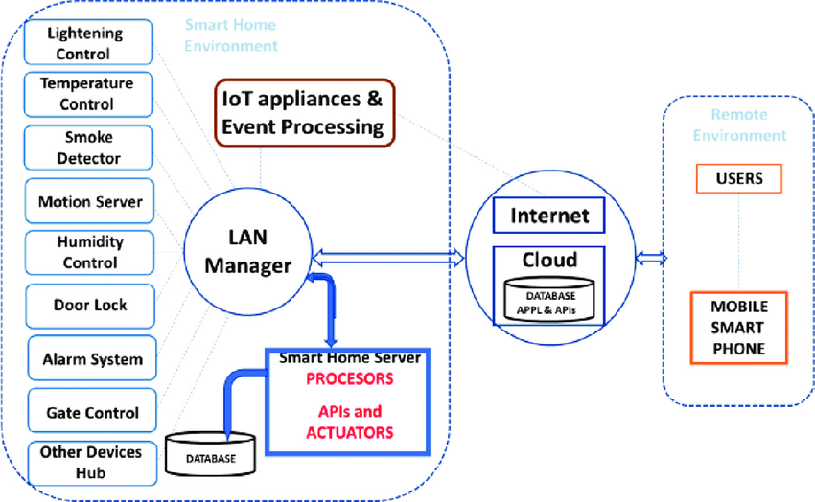
Proposed Approach

Slide 18
TECH REQUIREMENT
Arduino UNO
USB Sound Card
PIR Sensor
USB Hub
Internet
LCD Monitor

Slide 19
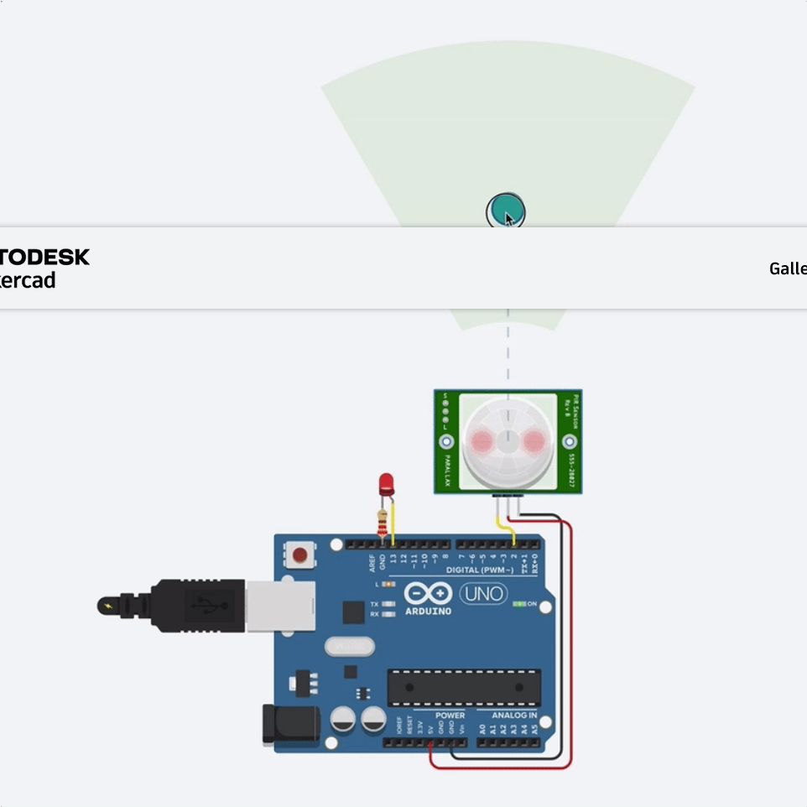
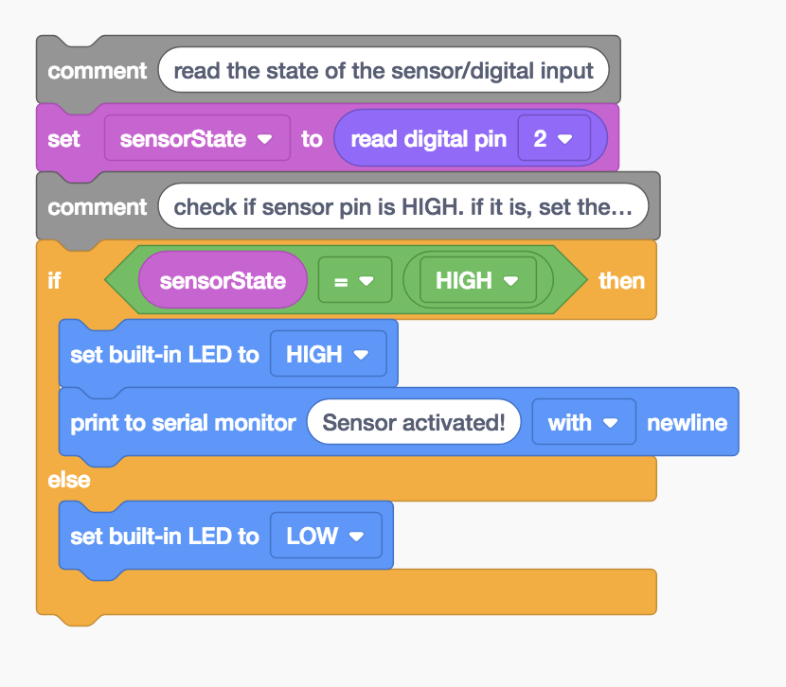
Experimental Setup

Slide 20
FUTURE SCOPE
Many people are already in bed with technology. Who hasn’t used their smartphone or tablet in bed? Yet others object to technology’s invasion of their bedroom. In particular, they worry about their exposure to electromagnetic waves and want to minimize the electric field in their sleeping environment. From this project, we can manage to reduce digital devices in the room.

Slide 21
CONCLUSION
Digital Logic Design is the representation of signals and sequences of a digital circuit through numbers. It is the basis for digital computing and provides a fundamental understanding of how circuits and hardware communicate within a computer. Digital logic is typically implanted into most electronic devices, including calculators, computers, video games, and watches. This project introduces how to connect IoT (internet of things) devices to the circuitry. This may relate to a professional engineering job by an engineer who may design smart devices. Many engineers may get into this field with the evolution of smart products, such as smart lights, smart homes, smart appliances, smart televisions, smartphones, and more.

Slide 22

Any Queries?

Slide 23
THANK YOU

